Slide 1
Library System Project
Group 9
AnduAlem Alemu Zemedkun
Binyam Gebregiorgis Kahsay
Ehab Ahmed
Elisabeth Asefa Abreha

Slide 2
Features:
Log In
Add new Library member
Edit Member
Add book copy
Checkout Book
Additional features we included
Print information of library members by their ID
Add Book

Slide 3
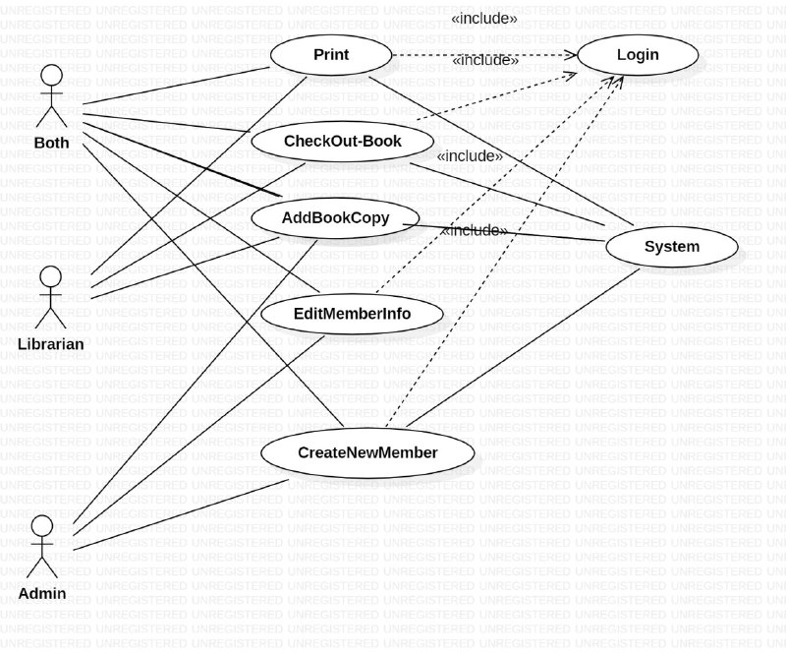
Use case Diagram for library System

Slide 4
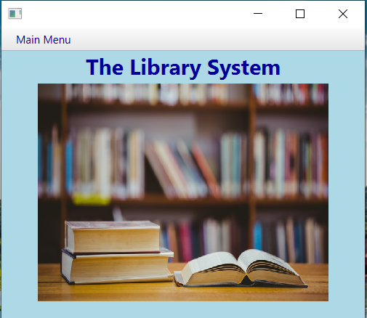
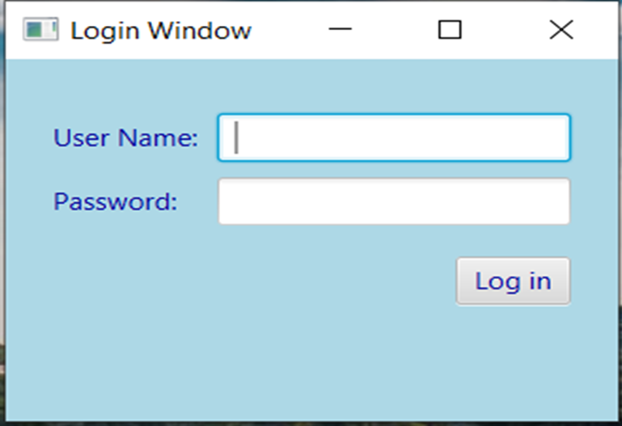
Main UI

Slide 5
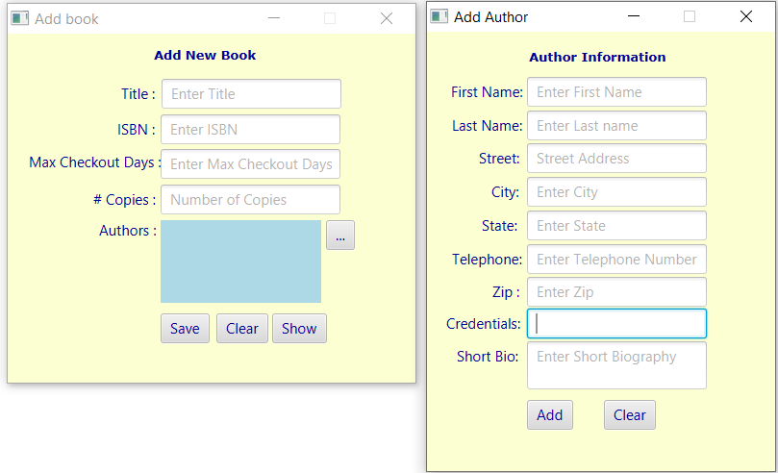
Add New Book

Slide 6
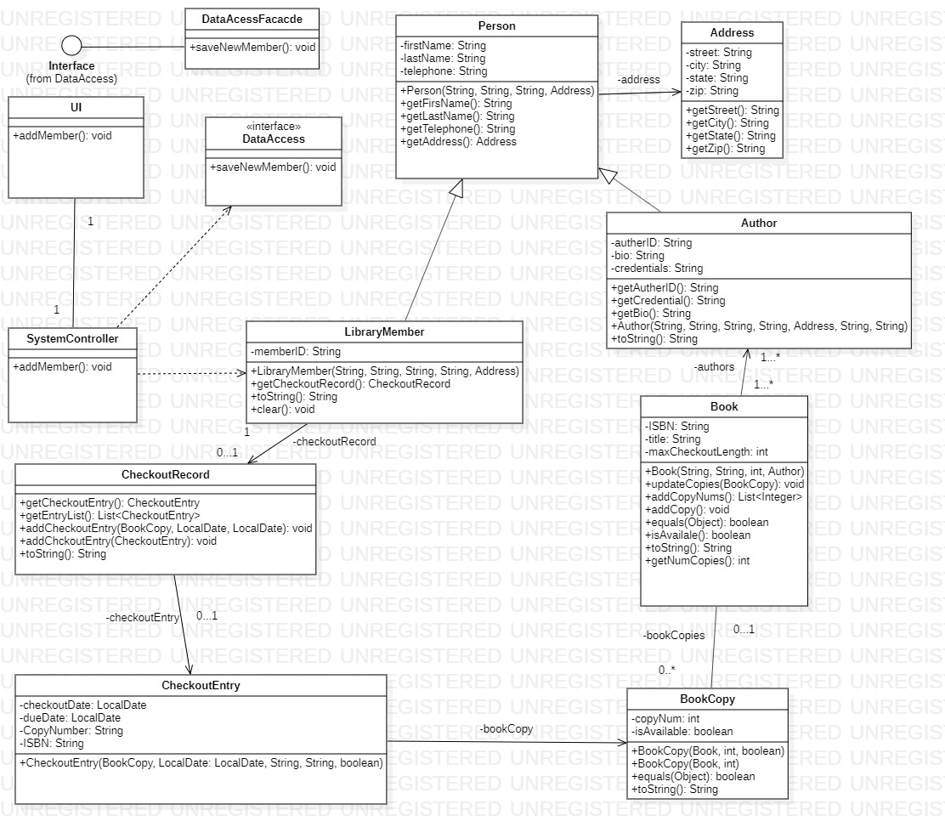
Class diagram:

Slide 7
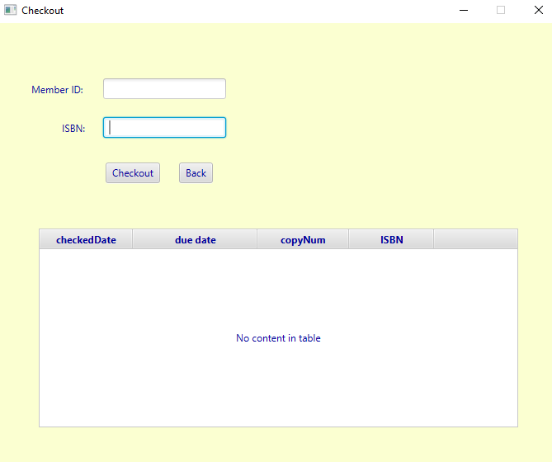
Checkout Book App screen

Slide 8
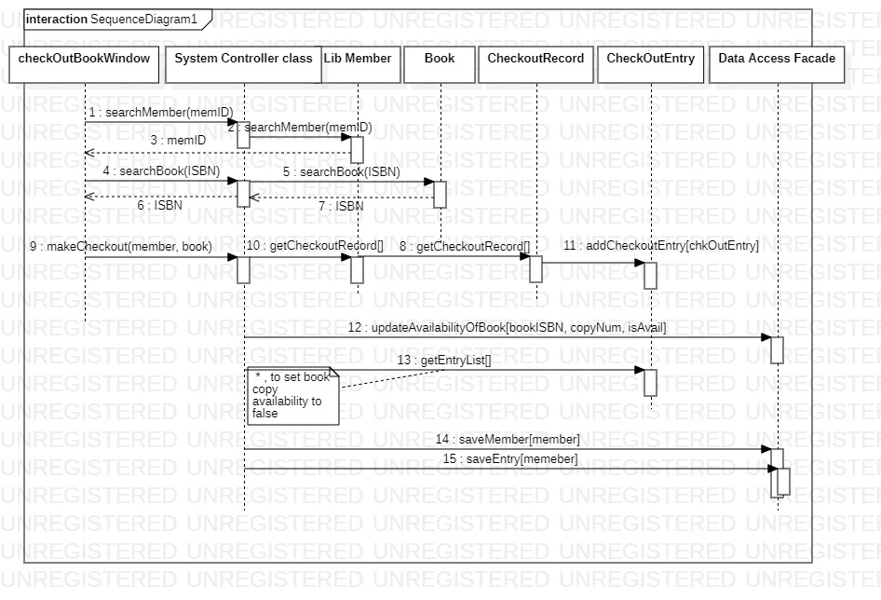
Sequence Diagram for “Checkout Book”

Slide 9
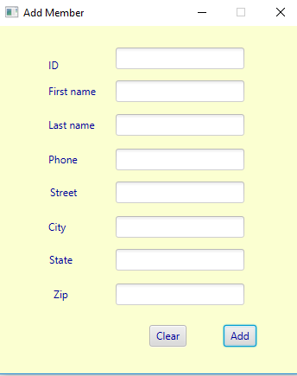
Add member UI

Slide 10
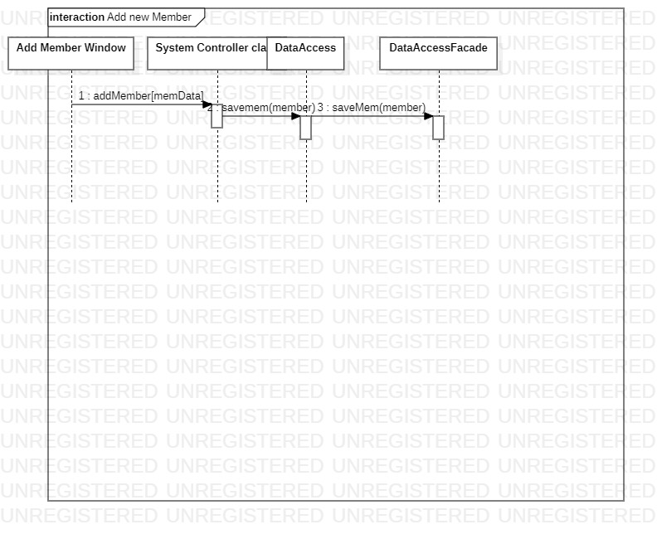
ADD member sequence diagram

Slide 11
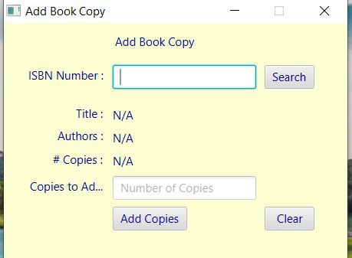
Add Copy of an Existing book screen

Slide 12
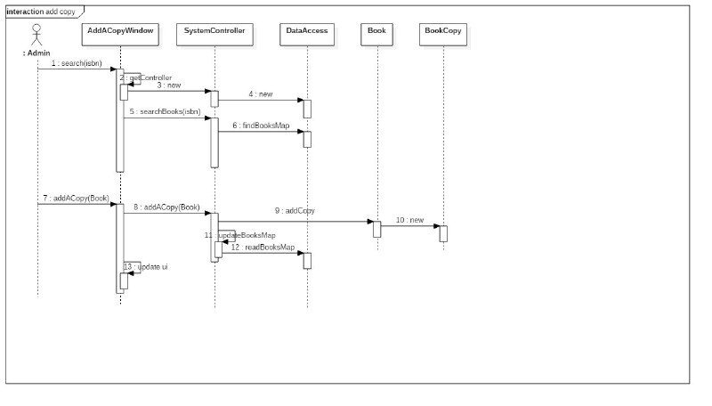
Add Copy of an Existing book

